Slide 1


PROJECT :
REVENUE ANALYSIS

Slide 2
ABOUT GARBHAGUDI
GarbhaGudi is a chain of new generation infertility treatment hospitals equipped with state-of-the-art infrastructure and cutting-edge technology to address this ever-increasing problem of infertility. It was founded by a team of committed entrepreneurs and healthcare specialists, led by Dr. Asha S Vijay, who is a renowned gynecologist and fertility specialist.
VISION OF GRABHAGUDI
"My GarbhaGudi shall be a globally renowned reproductive health university, having superlative success rates, due to strong scientific approach, ethical values and humane touch"

Slide 3
OBJECTIVE
The objective of this project is to create a detailed revenue analysis system that categorizes and visualizes revenue sources. This system will provide actionable insights through drill-down capabilities and a comprehensive dashboard, allowing for more informed decision-making and optimized revenue generation by tracking doctor-wise and procedure-wise contributions.

Slide 4
PROBLEM STATEMENT
Project : Revenue Analysis
Revenue Source Analysis: Categorize revenue into primary sources and sub-sources.
Provide drill-down capability to explore detailed revenue data.
b. Doctor-wise and Procedure-wise Revenue Dashboard: Develop a dashboard showing revenue generated by each doctor.
Include filters for time periods and drill-down options to view revenue by specific procedures.

Slide 5
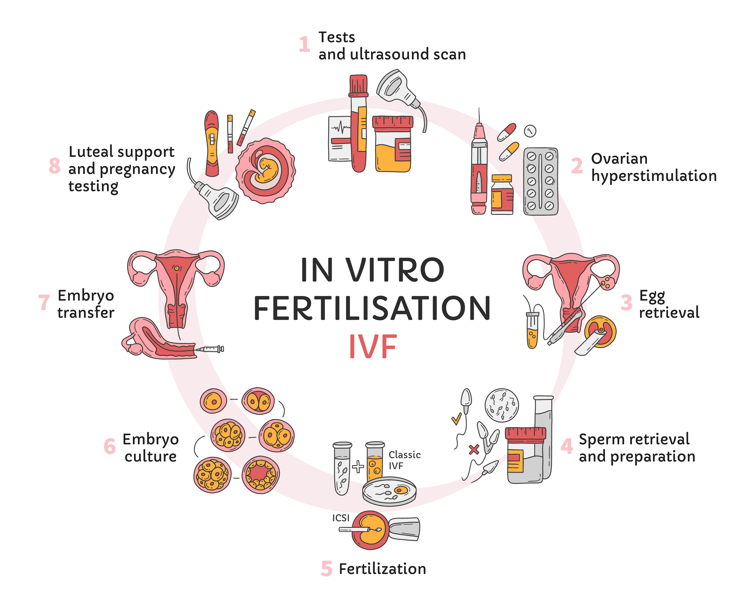
PROCESS OF IVF TREATMENT

Slide 6
PROPOSED TREATMENTS :
Blastocyst charges
Consultation
Diagnostic hysteroscopy
Diagnostic laproscopy
Do not use - new infertility registration
Donor frozen embryo transfer (dfet)
Donor oocyte
Embryo freezing
Embryo transfer
Embryolgy lab charges
Frozen embryo transfer procedure
Hysteroscopy under ga
Infertility specialist
Ivf - 1st cycle
Ivf charges
Ivf lab charges
New infertility registration
New registration
Sequential transfer
Tesa

Slide 7
PRIMARY SOURCES:
Anaesthetist charges
ANC consultation
ASST. Embryologist charges
Asst. Surgeon charges
Baseline scan
Beta human chorionic gonadotropin (βhcg)
Charges
Blood group & rh factor
Cervical stitch blastocyst
Complete blood count (cbc)
Consumables (ivf & culture media dish)
Doctor charges
Documentation charges
Donor semen sample for ivf
Embryo transfer under iv sedation
Embryologist charges
Embryology lab disposables
Endometrial receptivity array (era)
Estradiol (e2)
Fasting blood sugar (fbs)
Follicle stimulating hormone (fsh)
Follicular growth scan
Follicular scan
Frozen embryo transfer procedure
Fsh , lh ,estradiol(e2)
Glycosylated hemoglobin (hba1c)
Hb electrophoresis

Slide 8
SECONDARY SOURCES:
Lab Investigations
Consultation
OT Charges
IVF
Infertility
General Surgeries
Scan
Other Services - OP
Endoscopy Surgeries
Consumables
Operative Others
IUI
ANTI HBCAG -IGM

Slide 9





KEY PERFORMANCE INDICATORS(KPI’S)
Revenue by Sources
Revenue by Procedures
Revenue Growth Rate
Revenue by Doctors
Revenue from different Payment Methods

Slide 10
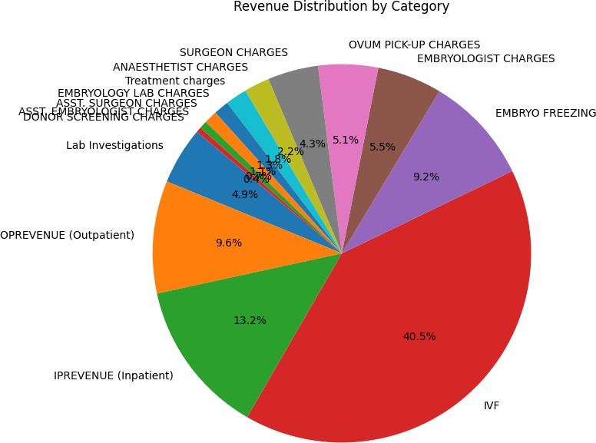
REVENUE BY PROCEDURE

Slide 11
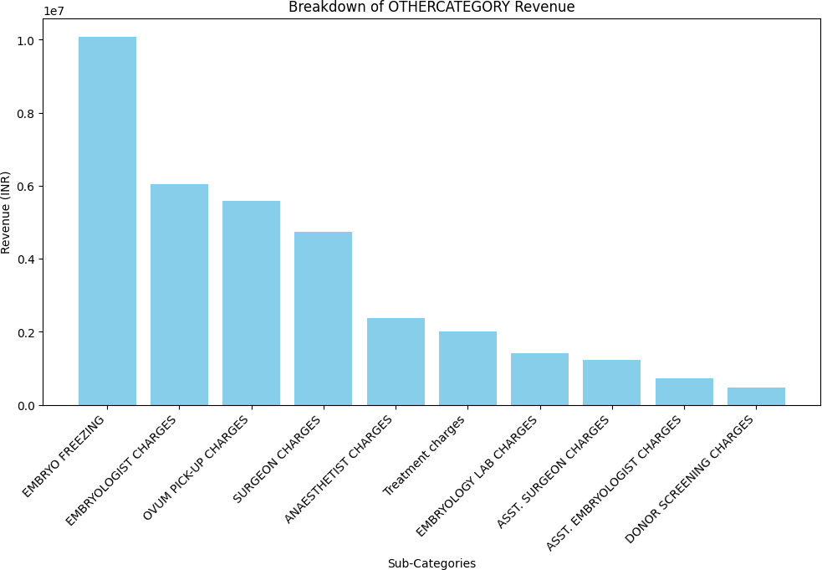
SUB CATEGORIES OF SOURCES

Slide 12
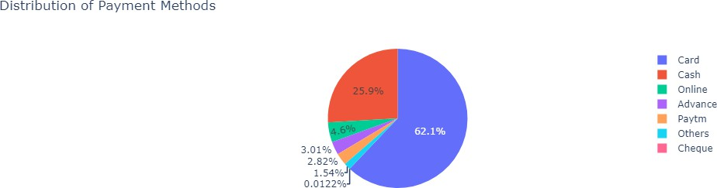
REVENUE THROUGH DIFFERENT PAYMENT METHODS

Slide 13
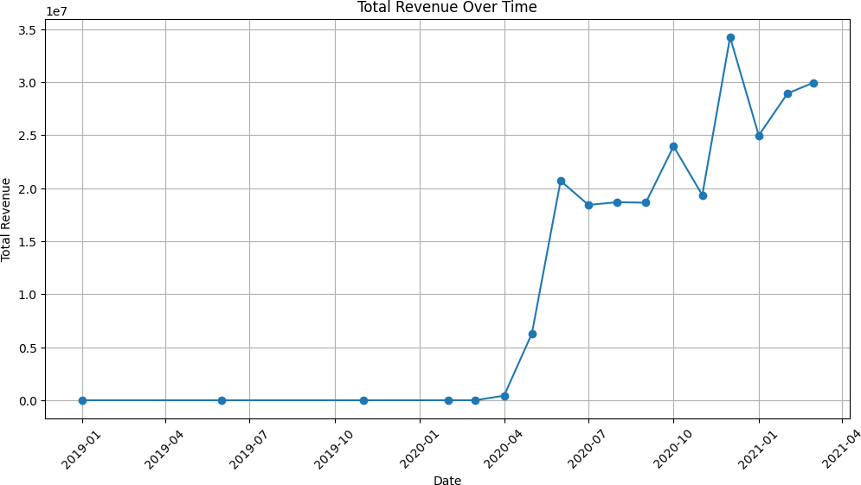
TOTAL REVENUE CHART

Slide 14
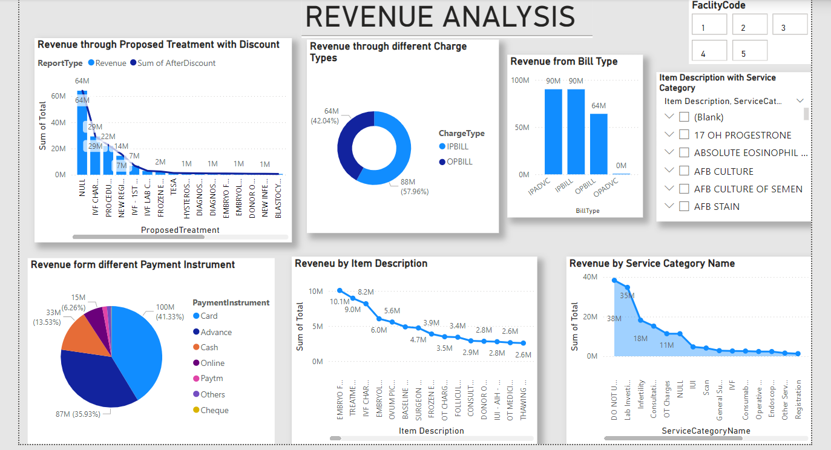

Slide 15
CONCLUSION
The Revenue Analysis project provides a detailed examination of the financial performance at the IVF center, categorizing revenue into primary sources and sub-sources while offering drill-down capabilities for deeper insights. The development of a doctor-wise and procedure-wise revenue dashboard allows for precise tracking of contributions from individual doctors and the effectiveness of specific procedures. These tools enable the IVF center to make data-driven decisions, optimize resource allocation, and enhance overall profitability, ultimately supporting strategic growth and sustainability.

Slide 16
THANK YOU
TEAM:
K. DEEPTHI – 23MG202A20
G. ANVITHA – 23MG202A13

